Slide 1
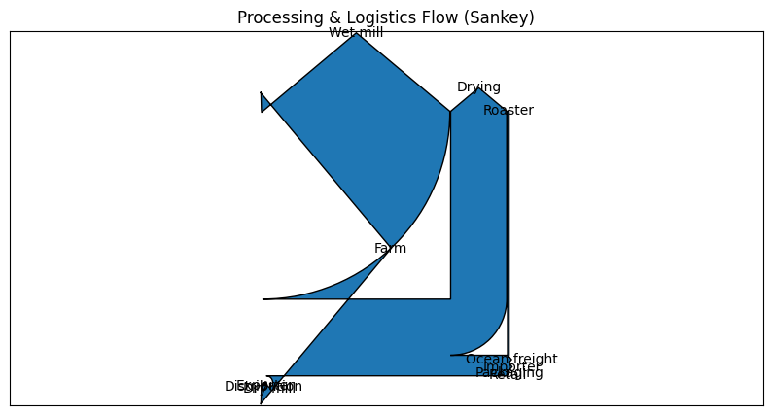
Mass flow baseline:
From 100 units cherries → ~20 units green → ~17 units roasted → ~16 units sold (losses, QC).
Energy hotspots:
- Roasting
- Brewing (consumer)
- Ocean freight (if air freight avoided)

